Slide 1

DATA EXPLORATION AND VISUALIZATION

Slide 2
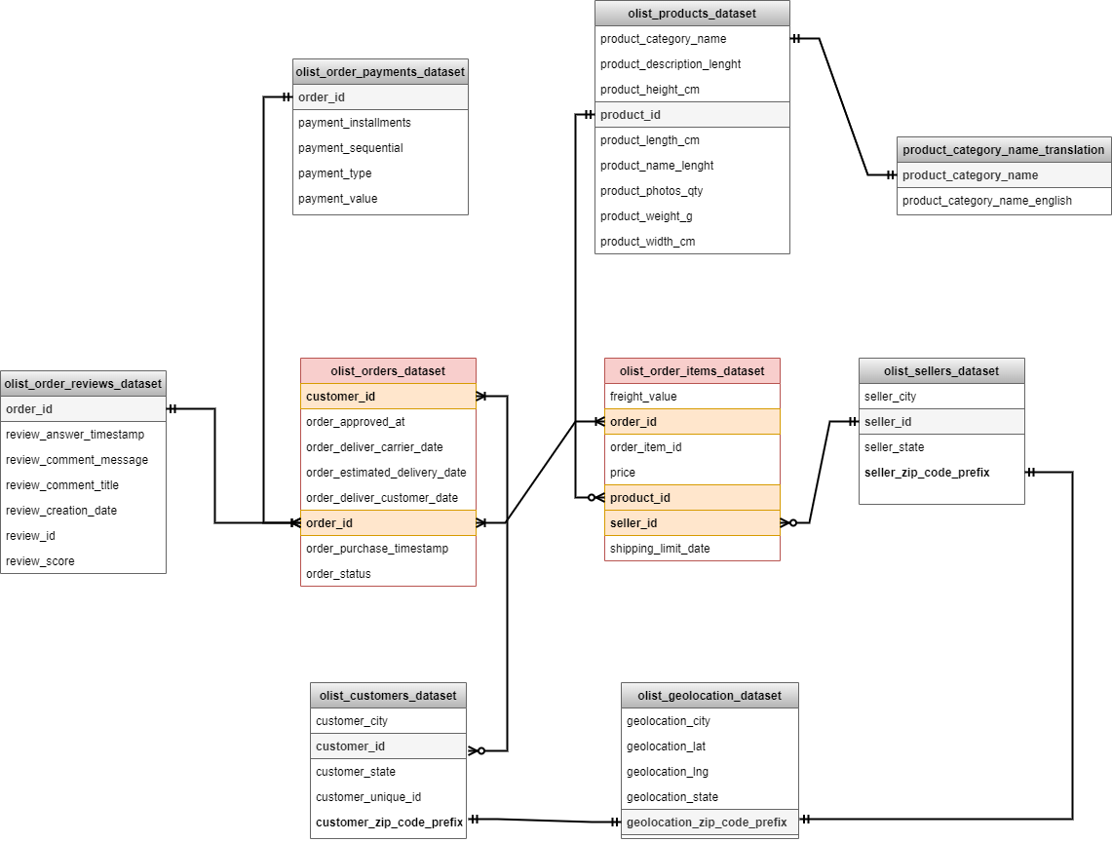
Data Exploration: EDA
Draw an ERD to explore the relationship between the dataset

Slide 3
Data Exploration: EDA
Why I do EDA?
Identify the faulty points in data -> easily remove them and clean your data
Help to understand the relationship between variables which gives us wider perspective on data
Steps to do EDA:
1. Understand dataset
Kind of data I working at, number of columns and rows, how it actually look likes
2. Clean your data from redundancies
3. Analysis of Relationship between variables:
Estimate the Central
Estimate the Variability
Explore the Distribution
Correlation

Slide 4
2. Business Acumen
Identify and measure at least three key suitable metrics to analyse the company performance and deliver insights for improvement
Explain your rationale behind those metrics
Provide supporting analysis and visualization to communicate your ideas to the CEO
Which additional data/dataset do you think the company should collect and why

Slide 5
Empathize
Understanding goals
2. Understanding dataset
8 tables:
Customers
Geolocation
Items
Payments
Reviews
Orders
Products
Sellers
Who is the report for? - CEO
What is the purpose of the report? -
Maximize GMV
Optimize spending
What is the desire of the viewer? - Make a decision/ suggestion

Slide 6
Empathize
Customers
Entity: customer
Dimension: id, state, city, unique_id
Metrics: most common state, city, retention rate
2. Geolocation
Entity: geolocation
Dimension: city, state
Metrics: distribution of customers in Brazil
3. Order Items
Entity: order_id, order_item_id, product_id, seller_id
Dimension: price, freight_value
Metrics: popular products, revenue per order, shipping spending, revenue per seller, revenue per product
Time: shipping_limit_date
4. Payments
Entity: order_id, payment_type
Dimension: payment_installments, payment_sequential, payment value
Metrics: most popular payment types, total payment_value by each type, tendency of installment

Slide 7
Empathize
5. Reviews
Entity: order_id, review_id
Dimension: review_score
Metrics: total score per order
Time: review_creation_date, review_answer_timestamp
6. Orders
Entity: customer_id, order_id, order_status
Dimension: time purchase, time approved, time delivery carrier, estimated delivery time, time to delivery customer on hand
Metrics: On-time rate
Time: all except entity
7. Products
Entity: product_id, product_category_name,
Dimension: length, height, photo_qty, weight, width
Metrics: relationship between product size and time shipping?
8. Sellers
Entity: seller_id
Dimension: seller_city, seller_state
Metrics: location of seller and relationship with location of customer, time shipping

Slide 8
Define
Scale up GMV and optimize spending are hard to do at the same time. Depend on the situation at each different stage of the company, they have to decide to increase GMV or cut cost.
Let come up with Maximize GMV first:
Most important metric: GMV (related to revenue)
Sub-metric: Thinking in different dimension:
Revenue = number of orders* AOV
Revenue = activation+reactivation
Revenue = revenue by channel
Revenue = revenue by category
Define important attributes
List down key metrics
Brainstorming question list
Ranking -> Pick

Slide 9
Revenue = number of orders * AOV
AOV
Want customers buy products with bigger prices
What are main strategy of sales?/ How products are selling?
Up-selling?
Gross-selling?
Can we find other sellers who manufacture products with higher prices?
Can we sell more expensive products?
Make customers buy more products -> make more selections
How many products are selling
What category has the most sold products
Increase number of orders
Increase AOV
Increase both
Number of orders
What is your targeted customers?
They live focusly on what region of country?
How many orders of each region?
How many orders of each group customers?

Slide 10
Revenue = activation+reactivation
Revenue = revenue by category
Get new users
Marketing channels
Make old users by again and again
Strategy for them
What category are the most favorite?
What category has biggest revenue?
What category has the most selection?
customer life cycle
retention rate
churn rate
=> not good to have more new users but churn rate are high
Cost to promotion to get new users vs Cost to increase user retention, which ones is bigger? -> suggest strategy

Slide 11
Optimize spending
Shipping cost
What are distances from seller to customers?
Decrease the distant or suggest sellers who have the same products in customer’s region to join/ sellers to move to region which have lots of customers purchasing their products
Or say ‘no’ for shipping, let sellers do shipping at their own
Warehouse cost
How to have the shortest time for warehouse?
Classify orders in the most convenient way
Eliminate abandoned orders -> sell with lower price

Slide 12
Recommendation
Maximize GMV | Assumption | Recommendation
Increase number of orders | target customers: Female, (Age), who interested in health and beauty number of orders come from East size which the population density is high defined unique_customer_id defined which customers buy most | designed target promotion for each target customer group send discount code for top frequent customers via their own account: unique_customer_id increase brand awareness in West size
Increase AOV Make people buy more products Make people buy products with higher price | need data about sales method, number of products selling with combo, hot deal Bed_bath_table are having the biggest quantity of products sold | 1.1 Create more selection for customers -> In top 5 categories: bed_bath_table, furniture_decor, health_beauty, sports_leisure and computer accessories 2.1 Up-selling: sell with combo, instead of single 2.2 Gross-selling: sell with hot deal 2.3 Find sellers in the same category but higher product price -> suggest they sell in the company website 2.4 Suggest more products in higher range prices

Slide 13
Maximize GMV | Assumption | Recommendation
Activation and Reactivation | need customer life cycle value retention rate are low: 3.12% need churn rate need number of old customers return | Sometimes new customers are increasing but churn rate are high => Should focus to get promotion for old users - increase retention rate Are cost of products reasonable? -> Customers do not like high freight cost
Category | Health and beauty bring the most valuable GMV Sold most products in bed_bath_table Bed_bath_table and sports leisure have the most selections | Focus on these categories
Channel | Need data of marketing channels

Slide 14
Optimize Spending | Assumption | Recommendation
Shipping expenses | Some are high, because of shipping oversea Most sellers are in Sao Paulo but most customers are in coastal cities | Optimize distances Increase orders in the same region, area Distribute sellers better Suggest sellers in SP that most of customers of their products are in coastal cities -> they should move to these cities Find sellers who sell the same products but live in coastal cities -> suggest them to join ecommerce Cut cost: let sellers do their shipping
Warehouse expenses | Need data in warehouse | Classify orders in right way Eliminate the inventory
Marketing expenses | Need data about marketing expenses to get new users and to increase retention rate | Compare the expenses -> to action that we should acquire more customers or focus on old customers, loyalty customers

